Slide 1


Deep Learning Theory and Applications Spectral Graph Convolutional Networks
CPSC/AMTH 663
CPSC 452

Slide 2
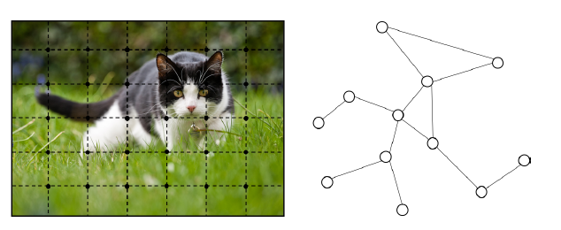
Images are a specific sort of graph—grid graph

Slide 3
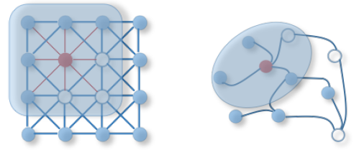
More general graph structures

Slide 4
Recall: CNNs use three basic ideas
Local receptive fields
Problem: There is no clearly defined direction or method of translation over a graph (cannot cleanly slide a convolution)
Shared weights
Pooling
Could potentially be achieved with graph clustering!

Slide 5
How can we approximate these on more general non-grid graphs
Spatial construction (Bruna, Hamilton)
Apply the same operator and move over the graph space in some fashion
Notion of locality based on neighbors of a node
Spectral construction (Bruna, Defferard)
Define a convolutional operation in the graph spectral space
Uses signal processing theory to define filters in the graph Fourier domain
Notion of locality based on global properties of the filter

Slide 6
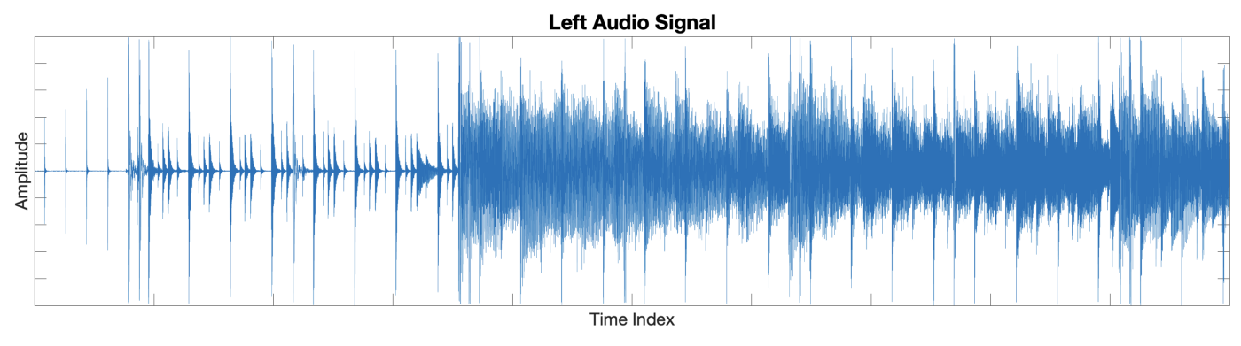
Time series signals
https://towardsdatascience.com/the-wavelet-transform-e9cfa85d7b34

Slide 7
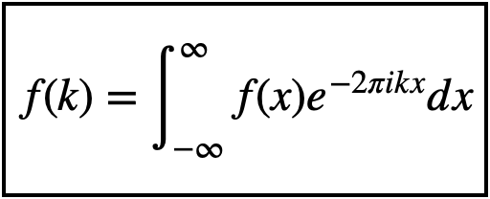
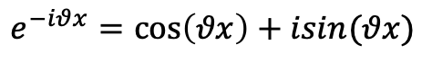
Fourier Transform of a Signal
Recall Euler’s formula:
$$e^{−iθx}=\cos\left(θx\right)+isin(θx)$$

Slide 8
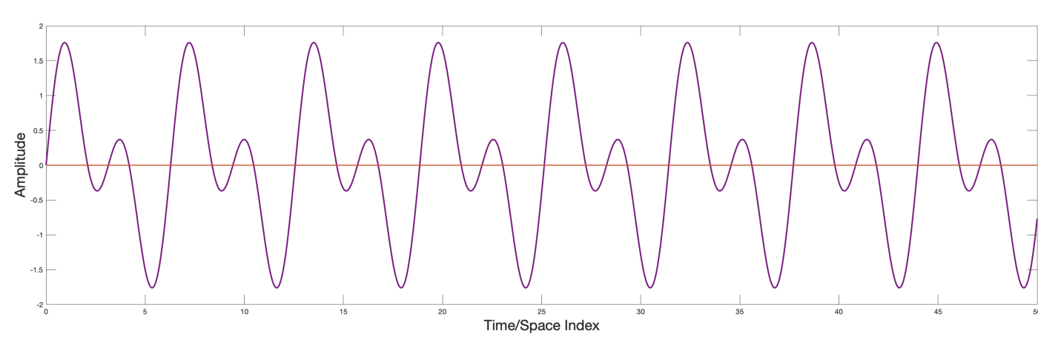
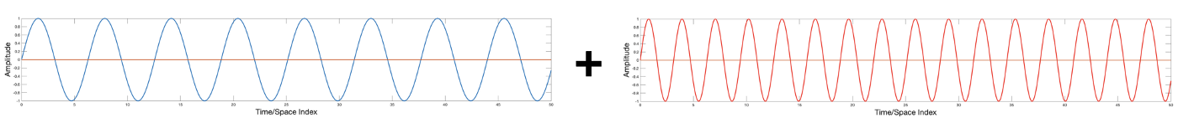
Decomposes signal into frequences

Slide 9
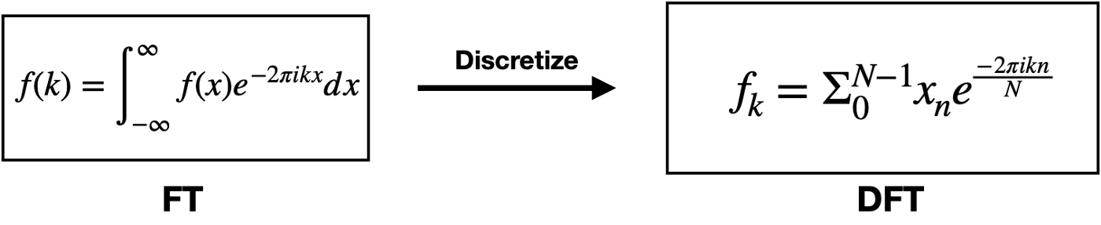
Discrete Fourier Transform
Usually we don’t have the functional form available for computing the integral, so we use discrete samples and discrete wavelengths

Slide 10
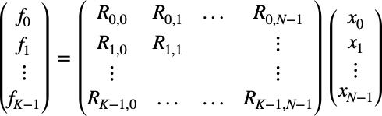
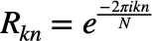

DFT is a matrix multiplication
$R_{k,n}$ is the value of the kth waveform at time index n

Slide 11
Fourier transforms have numerous uses
Power spectral analysis
Solutions of differential equations (heat equation)
Audio and image processing
…much more

Slide 12
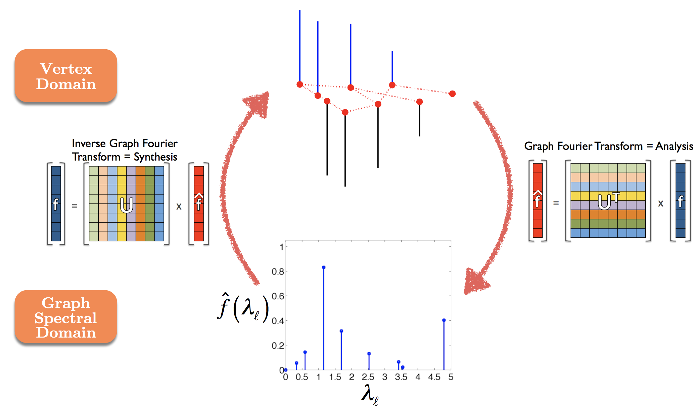
Signals on a graph substrate
These signals have an analogous Graph Fourier Transform
Involves using the eigenvectors of the graph Laplacian as the waveforms

Slide 13
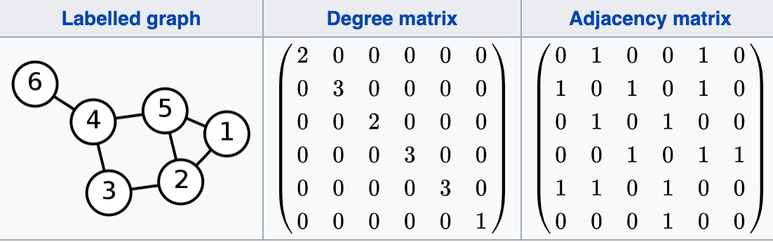
Graphs, Degree Matrix, Adjacency Matrix

Slide 14
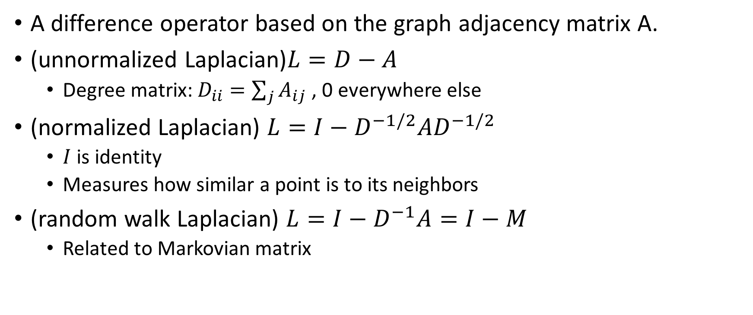
Graph Laplacian
A difference operator based on the graph adjacency matrix A.
(unnormalized Laplacian)$L=D−A$
Degree matrix: $D_{ii}=\sum_{j}{A_{ij}}$ , 0 everywhere else
(normalized Laplacian) $L=I−D^{−1/2}{AD}^{−1/2}$
$I$ is identity
Measures how similar a point is to its neighbors
(random walk Laplacian) $L=I−D^{−1}A=I−M$
Related to Markovian matrix

Slide 15
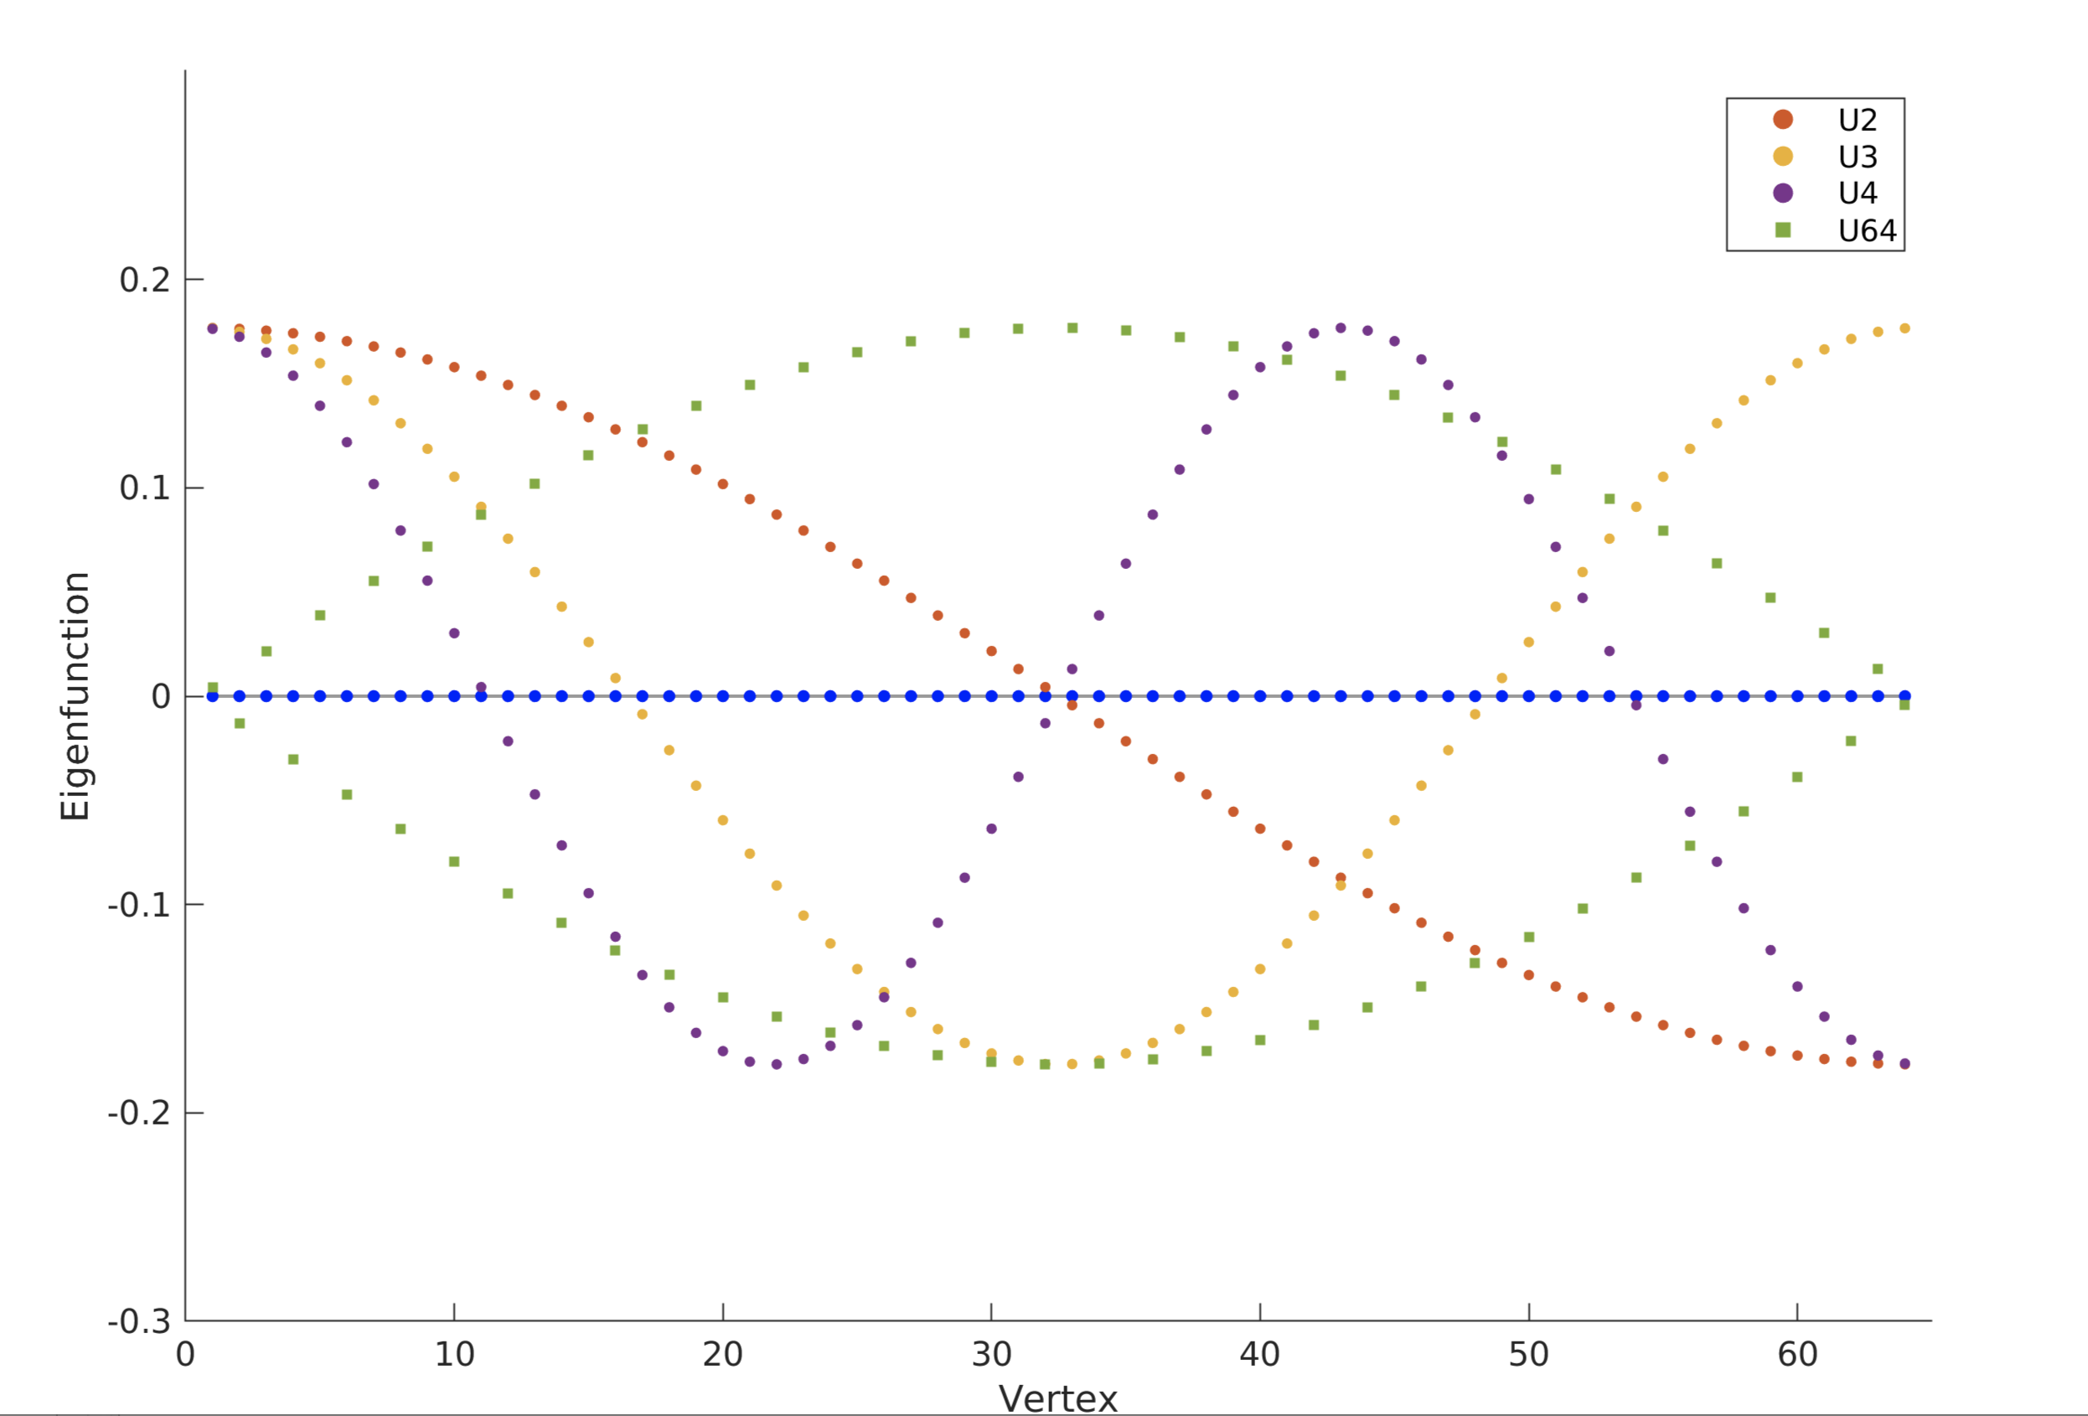
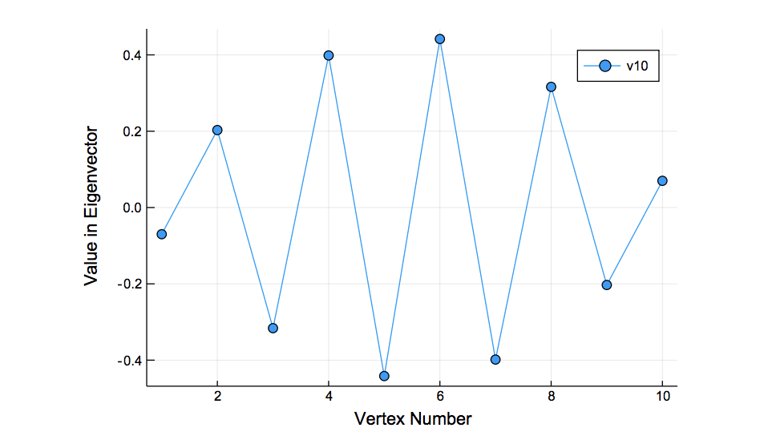
Eigenvectors form a Graph Fourier Spectrum

Slide 16
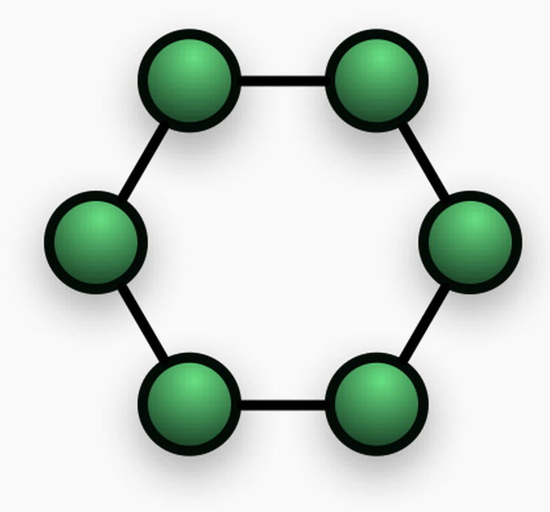
Graph Laplacian
Imagine the Graph Laplacian is created from a dataset with features
One feature is X
X(i) is X evaluate at node i
First derivative in discrete graph setting is the difference:
d(i)= X(i)-X(i-1)
d(i+1)=X(i+1)-X(i)
Second derivative
d(i+1)-d(i)
=X(i+1)-2X(i)+X(i-1)
X(i+1)
X(i)
X(i-1)

Slide 17
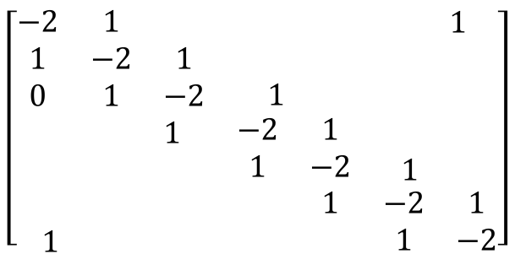
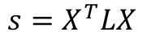
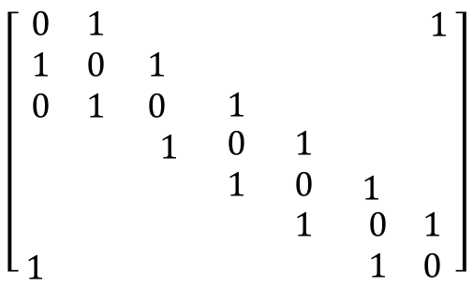
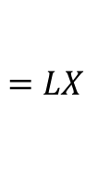
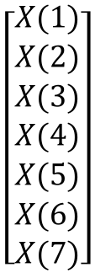
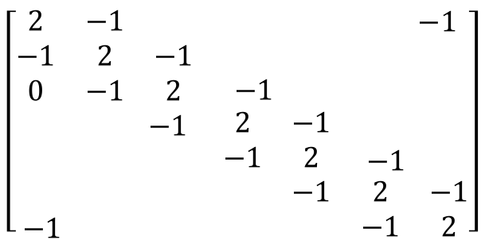
Based on Adjacency Matrix
$$\left[\begin{matrix}\begin{matrix}0 & 1 & \\ 1 & 0 & 1 \\ 0 & 1 & 0\end{matrix} & \begin{matrix} & & \begin{matrix} & 1\end{matrix} \\ & & \begin{matrix} & \end{matrix} \\ 1 & & \begin{matrix} & \end{matrix}\end{matrix} \\ \begin{matrix} & & 1 \\ & & \\ \begin{matrix} \\ 1\end{matrix} & \begin{matrix} \\ \end{matrix} & \begin{matrix} \\ \end{matrix}\end{matrix} & \begin{matrix}0 & 1 & \begin{matrix} & \end{matrix} \\ 1 & 0 & \begin{matrix}1 & \end{matrix} \\ \begin{matrix} \\ \end{matrix} & \begin{matrix}1 \\ \end{matrix} & \begin{matrix}\begin{matrix}0 \\ 1\end{matrix} & \begin{matrix}1 \\ 0\end{matrix}\end{matrix}\end{matrix}\end{matrix}\right]$$
$$\left[\begin{matrix}\begin{matrix}−2 & 1 & \\ 1 & −2 & 1 \\ 0 & 1 & −2\end{matrix} & \begin{matrix} & & \begin{matrix} & 1\end{matrix} \\ & & \begin{matrix} & \end{matrix} \\ 1 & & \begin{matrix} & \end{matrix}\end{matrix} \\ \begin{matrix} & & 1 \\ & & \\ \begin{matrix} \\ 1\end{matrix} & \begin{matrix} \\ \end{matrix} & \begin{matrix} \\ \end{matrix}\end{matrix} & \begin{matrix}−2 & 1 & \begin{matrix} & \end{matrix} \\ 1 & −2 & \begin{matrix}1 & \end{matrix} \\ \begin{matrix} \\ \end{matrix} & \begin{matrix}1 \\ \end{matrix} & \begin{matrix}\begin{matrix}−2 \\ 1\end{matrix} & \begin{matrix}1 \\ −2\end{matrix}\end{matrix}\end{matrix}\end{matrix}\right]$$
2nd derivative=
A-D
A=
$$\left[\begin{matrix}\begin{matrix}2 & −1 & \\ −1 & 2 & −1 \\ 0 & −1 & 2\end{matrix} & \begin{matrix} & & \begin{matrix} & −1\end{matrix} \\ & & \begin{matrix} & \end{matrix} \\ −1 & & \begin{matrix} & \end{matrix}\end{matrix} \\ \begin{matrix} & & −1 \\ & & \\ \begin{matrix} \\ −1\end{matrix} & \begin{matrix} \\ \end{matrix} & \begin{matrix} \\ \end{matrix}\end{matrix} & \begin{matrix}2 & −1 & \begin{matrix} & \end{matrix} \\ −1 & 2 & \begin{matrix}−1 & \end{matrix} \\ \begin{matrix} \\ \end{matrix} & \begin{matrix}−1 \\ \end{matrix} & \begin{matrix}\begin{matrix}2 \\ −1\end{matrix} & \begin{matrix}−1 \\ 2\end{matrix}\end{matrix}\end{matrix}\end{matrix}\right]$$
$$\left[\begin{matrix}X(1) \\ X(2) \\ \begin{matrix}X(3) \\ X(4) \\ \begin{matrix}X(5) \\ X(6) \\ X(7)\end{matrix}\end{matrix}\end{matrix}\right]$$
L=D-A
$$=LX$$
Estimates smoothness of X at each point
$${s=X}^{T}LX$$
s gives smoothness as a score, lower s is more smooth
L
X

Slide 18
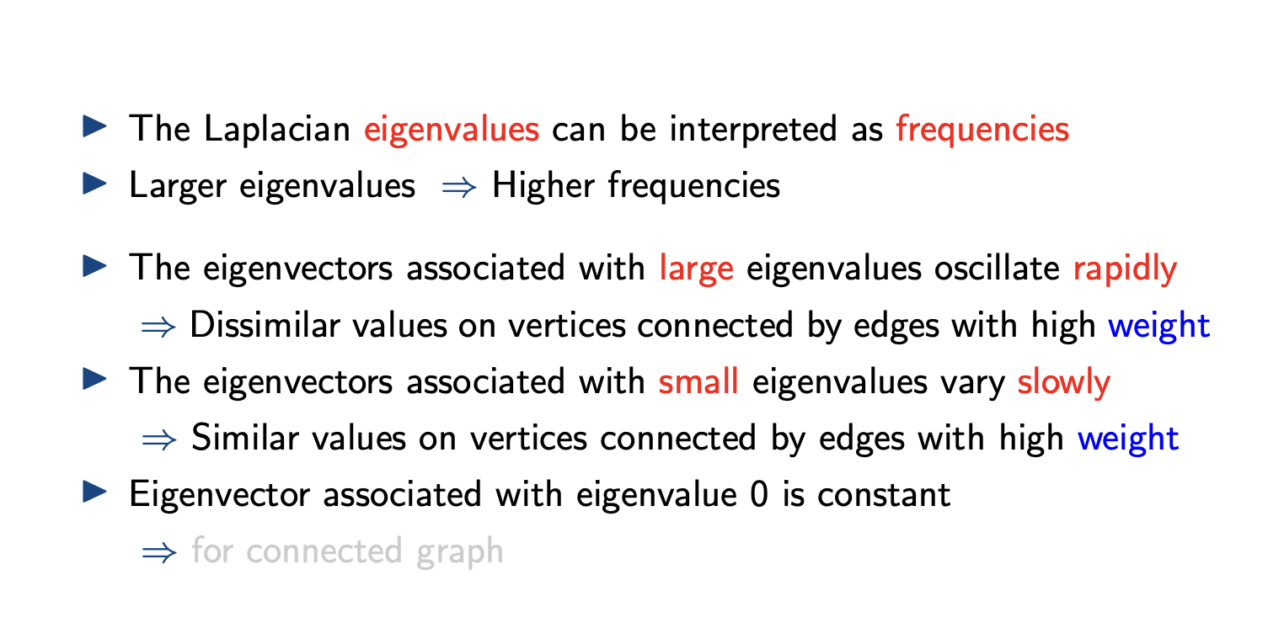
https://www.seas.upenn.edu/~ese224/slides/900_graph_signal_processing.pdf

Slide 19
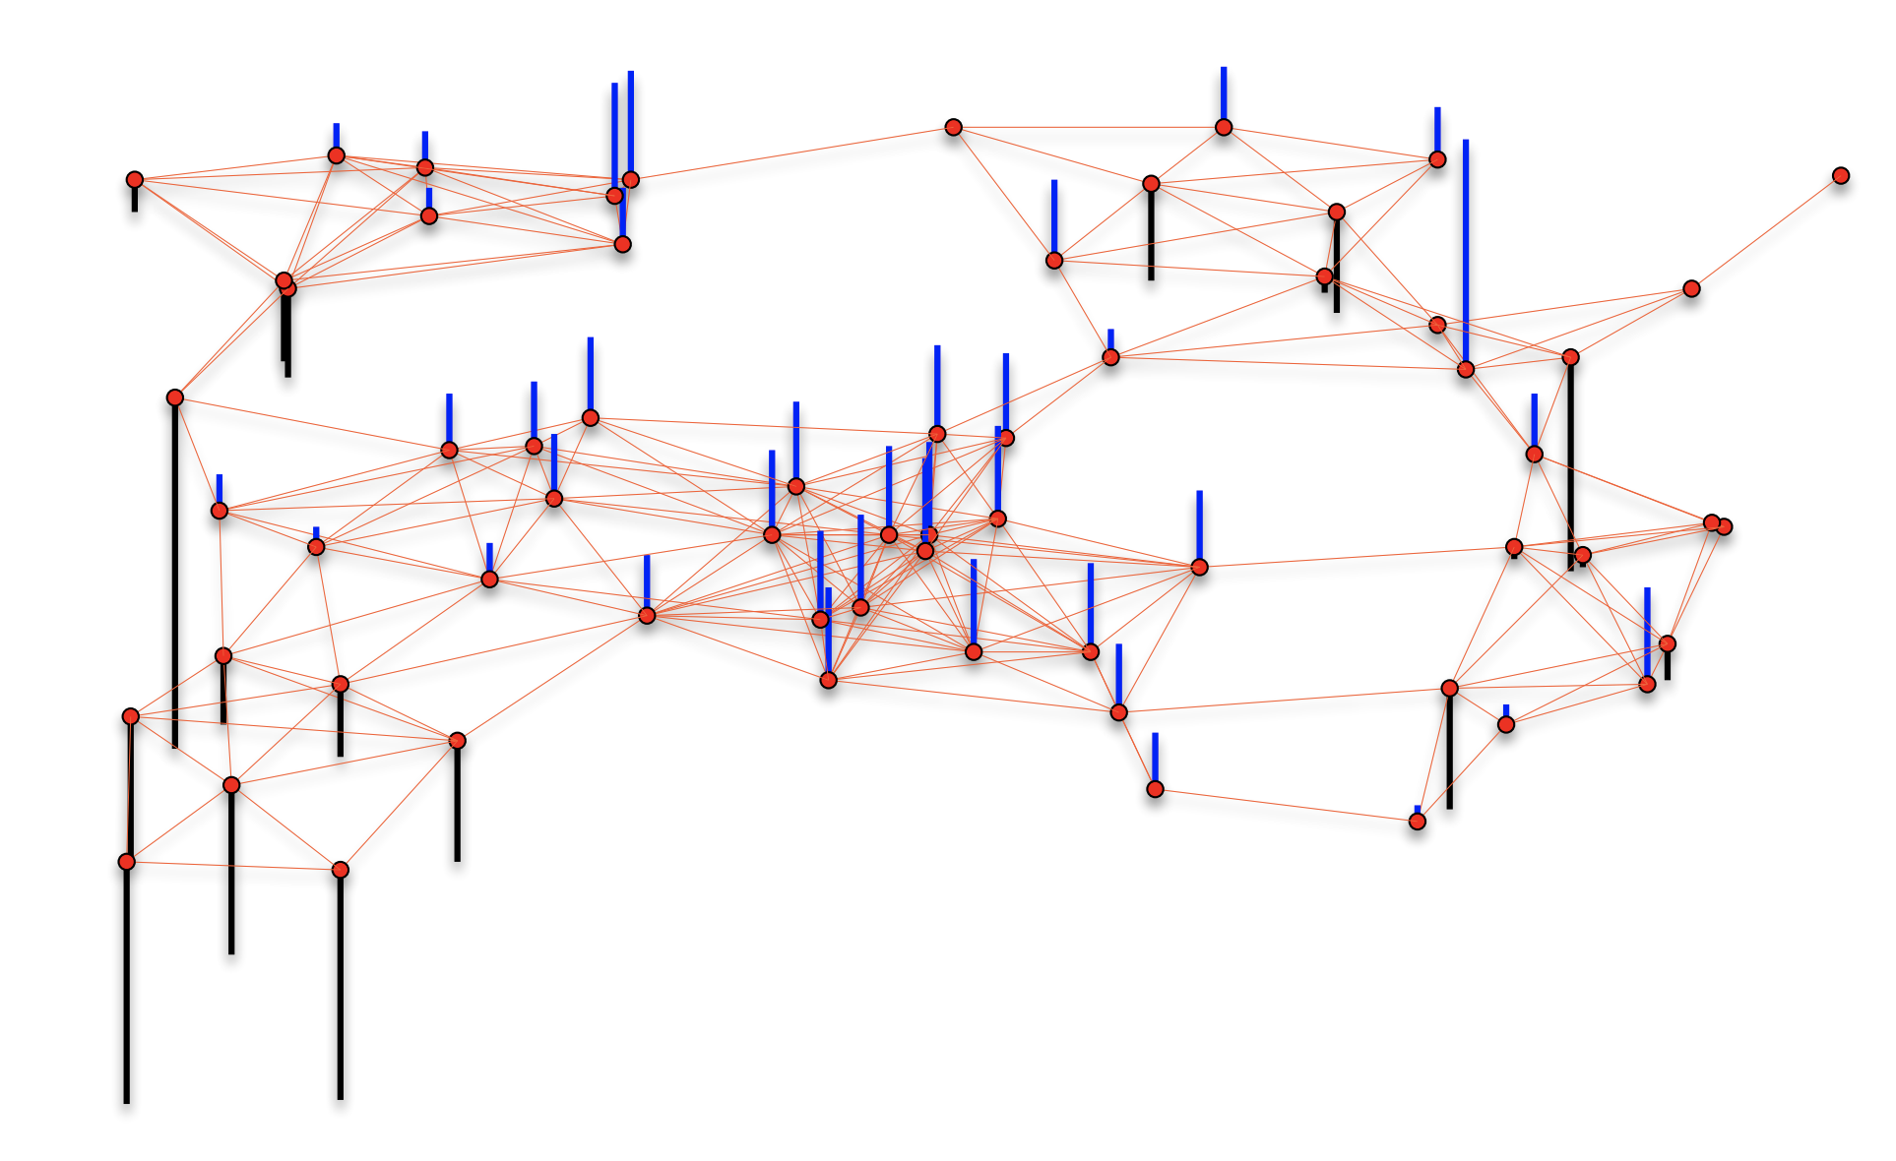
Features are signals on a graph

Slide 20
Graph Fourier Transform

Slide 21
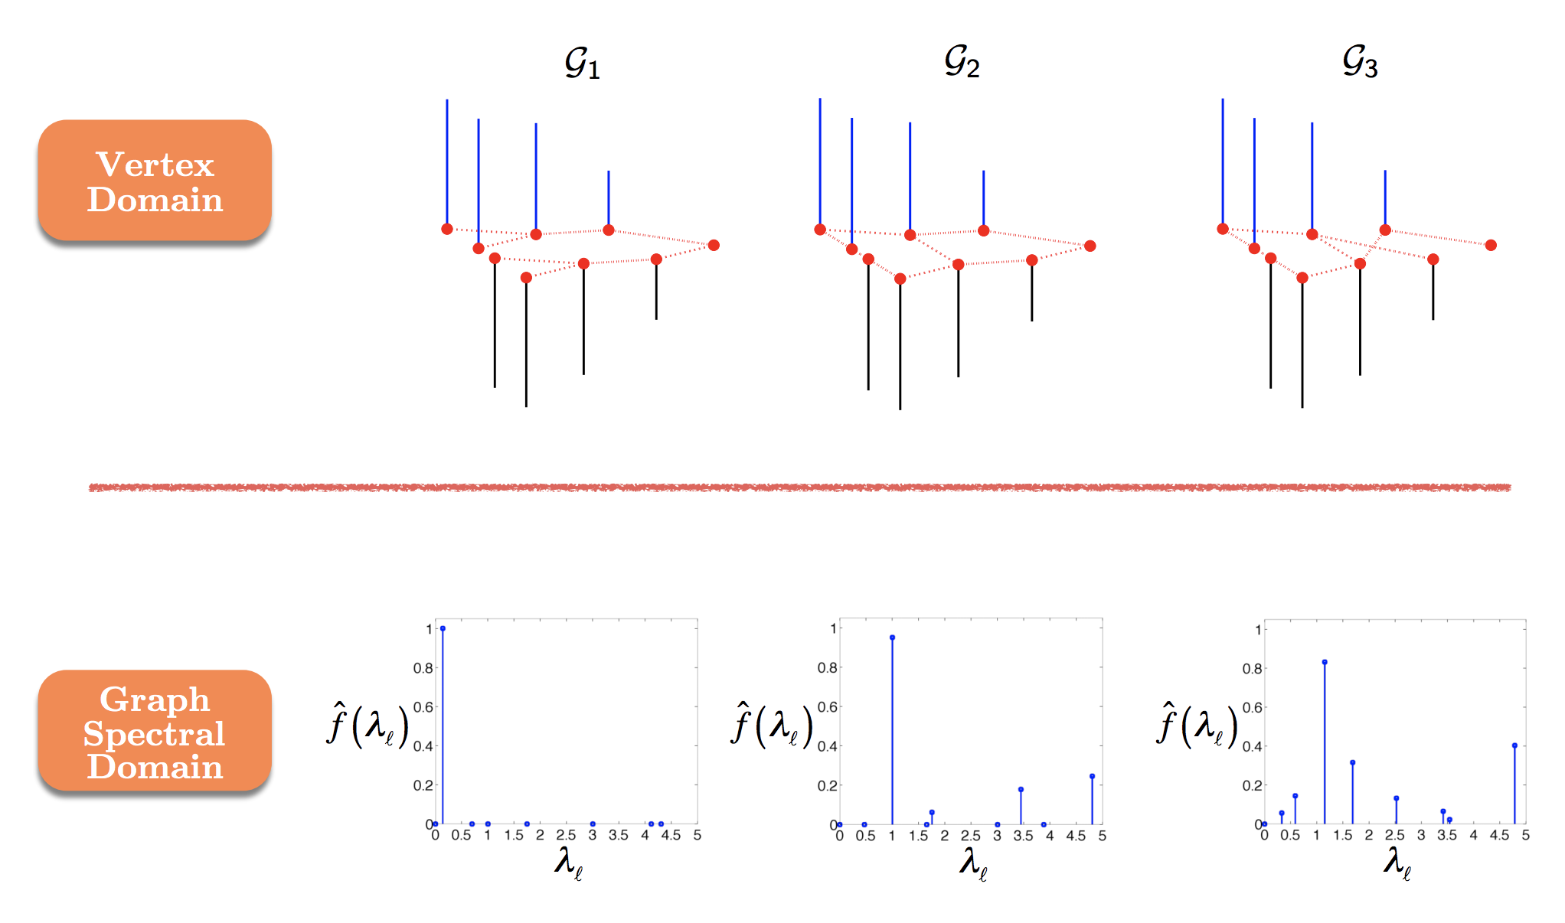

Slide 22
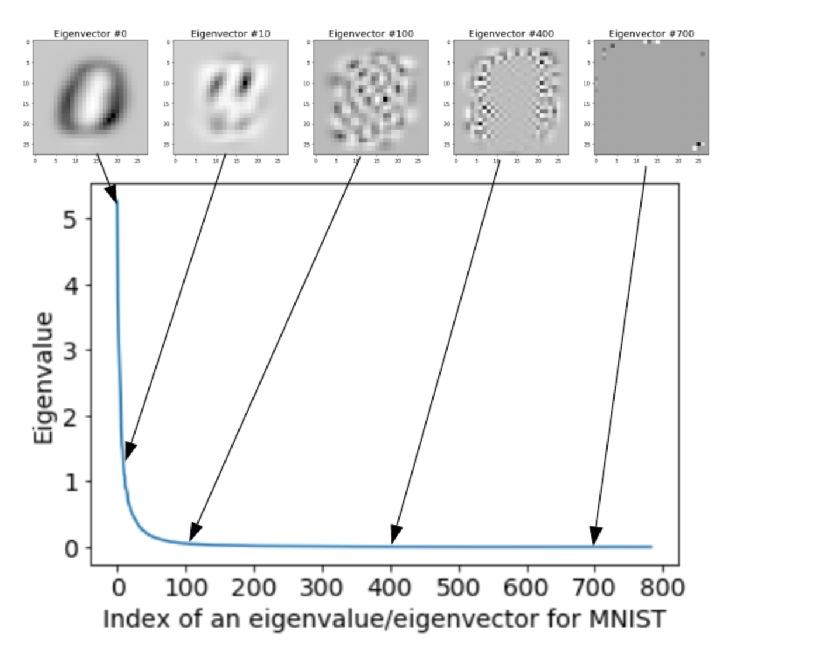
Laplacian Eigenvectors

Slide 23
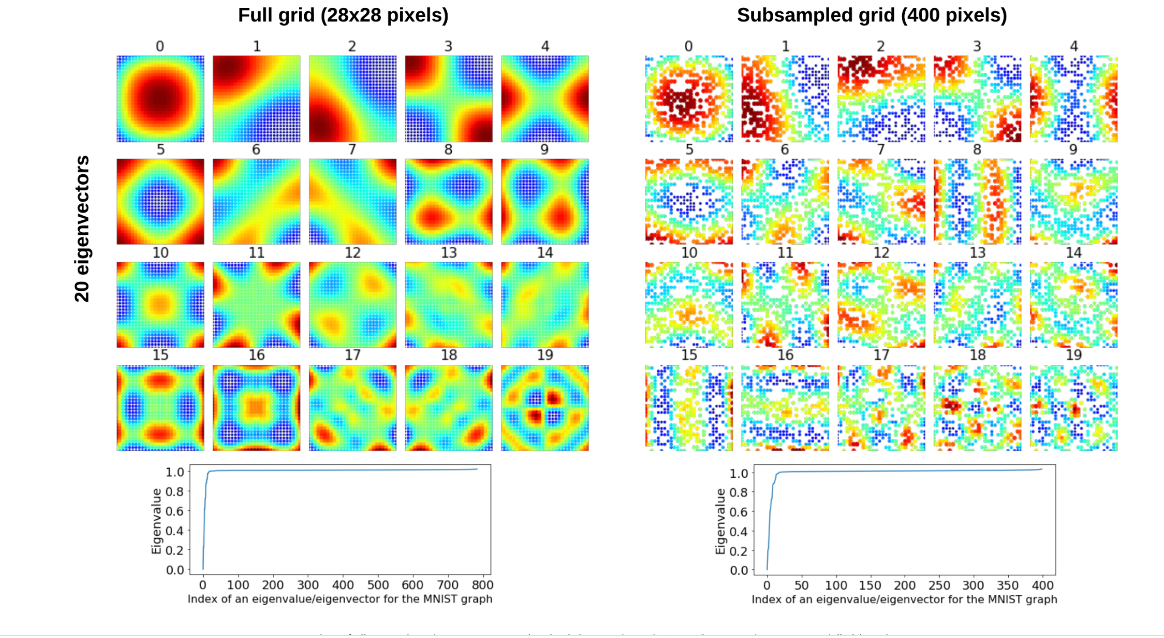
Subsampled Graph

Slide 24
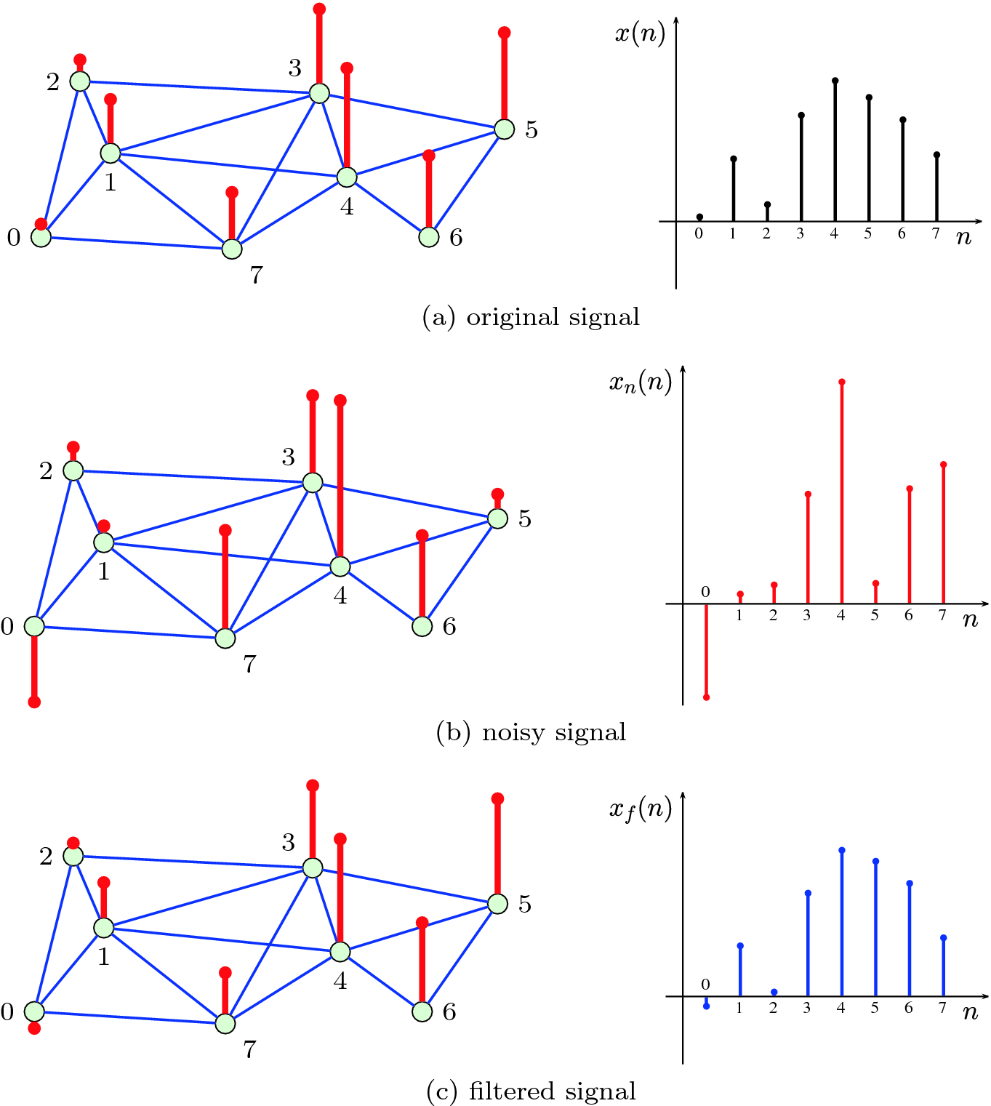
Spectral Graph Filtering
Stankovic et al. 2018

Slide 25
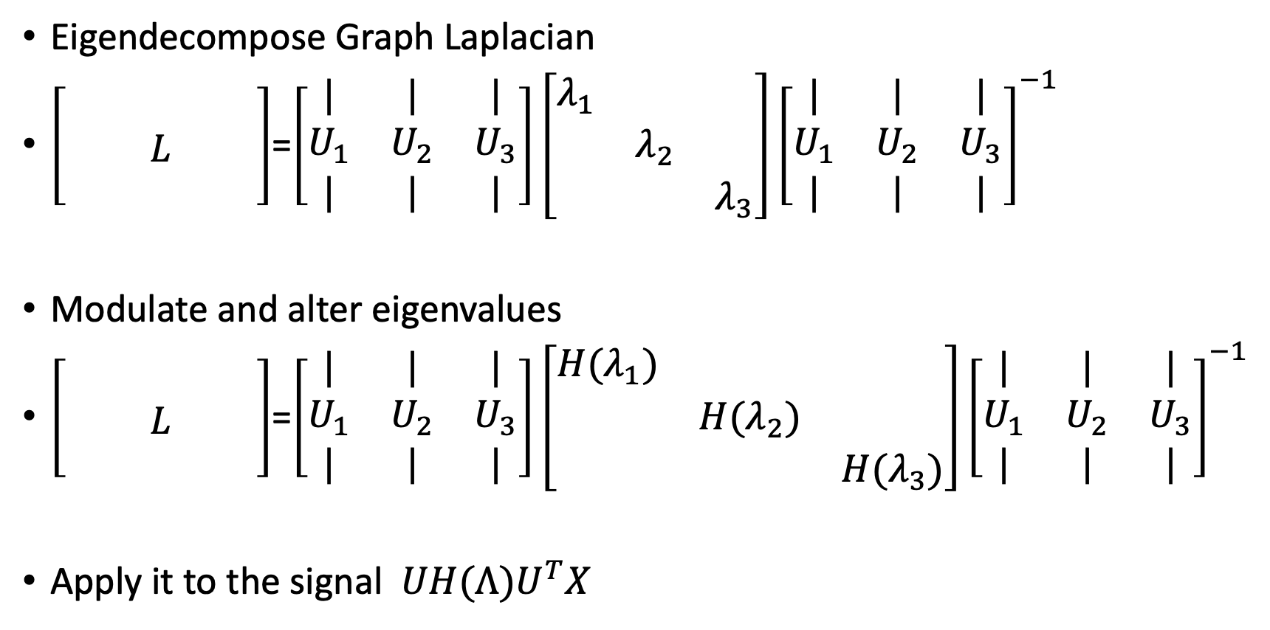
General Filter Construction
Eigendecompose Graph Laplacian
$\left[\begin{matrix} & & \\ & L & \\ & & \end{matrix}\right]$=$\left[\begin{matrix}| & | & | \\ U_{1} & U_{2} & U_{3} \\ | & | & |\end{matrix}\right]\left[\begin{matrix}λ_{1} & & \\ & λ_{2} & \\ & & λ_{3}\end{matrix}\right]{\left[\begin{matrix}| & | & | \\ U_{1} & U_{2} & U_{3} \\ | & | & |\end{matrix}\right]}^{−1}$
Modulate and alter eigenvalues
$\left[\begin{matrix} & & \\ & L & \\ & & \end{matrix}\right]$=$\left[\begin{matrix}| & | & | \\ U_{1} & U_{2} & U_{3} \\ | & | & |\end{matrix}\right]\left[\begin{matrix}{H(λ}_{1}) & & \\ & H(λ_{2}) & \\ & & H(λ_{3})\end{matrix}\right]{\left[\begin{matrix}| & | & | \\ U_{1} & U_{2} & U_{3} \\ | & | & |\end{matrix}\right]}^{−1}$
Apply it to the signal $UH(Λ)U^{T}X$

Slide 26
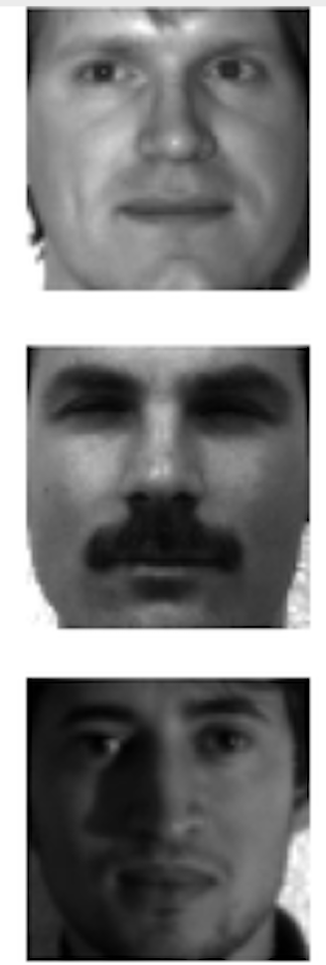
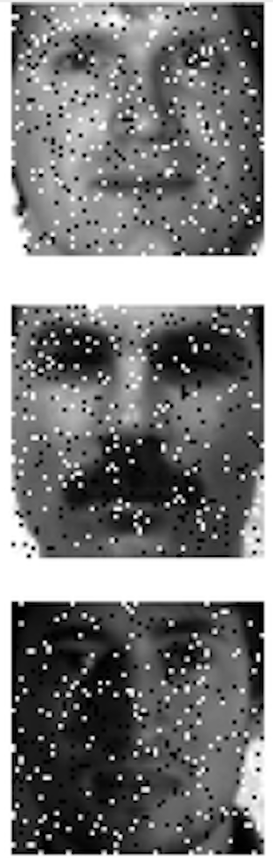
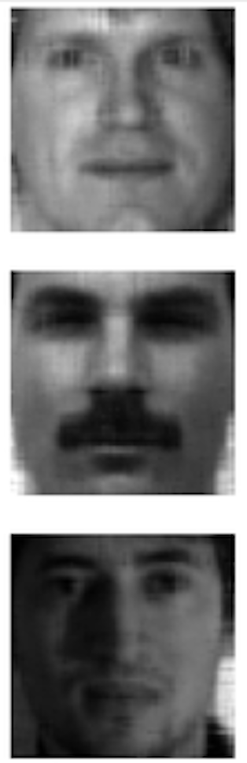
Data signals are low frequency, Noisy can be high frequency
Can take off noise by taking off high frequency eigenvectors

Slide 27
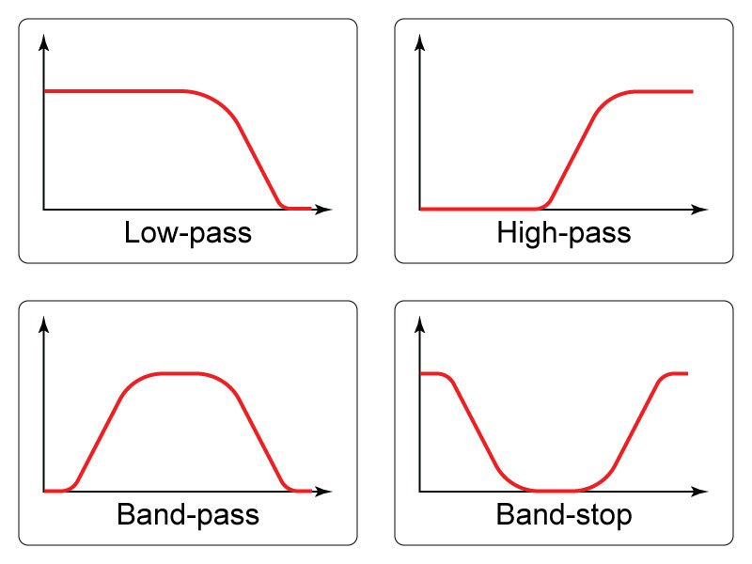
Low-pass filter

Slide 28
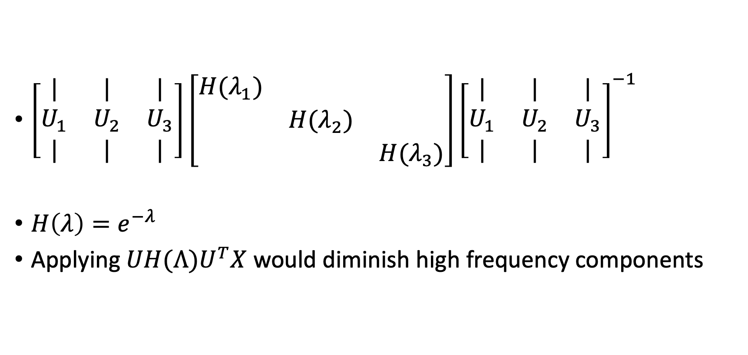
Example of a low pass filter
$\left[\begin{matrix}| & | & | \\ U_{1} & U_{2} & U_{3} \\ | & | & |\end{matrix}\right]\left[\begin{matrix}{H(λ}_{1}) & & \\ & H(λ_{2}) & \\ & & H(λ_{3})\end{matrix}\right]{\left[\begin{matrix}| & | & | \\ U_{1} & U_{2} & U_{3} \\ | & | & |\end{matrix}\right]}^{−1}$
$H\left(λ\right)=e^{−λ}$
Applying $UH(Λ)U^{T}X$ would diminish high frequency components

Slide 29
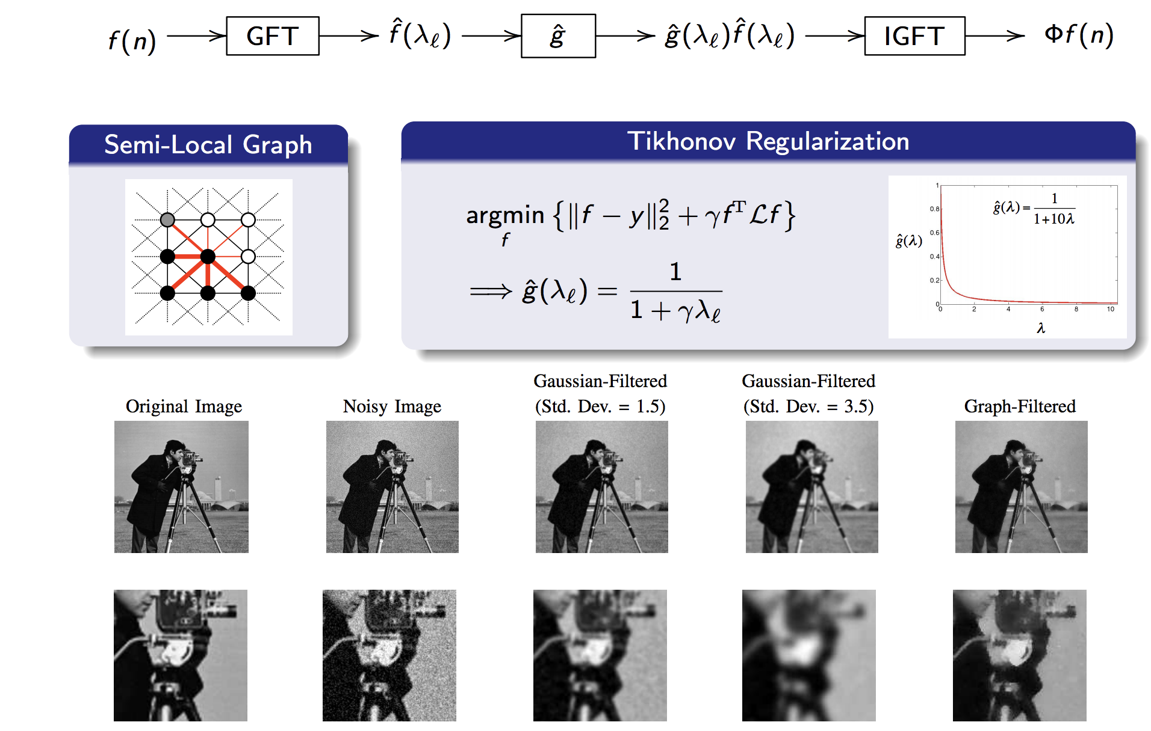
Image Denoising

Slide 30
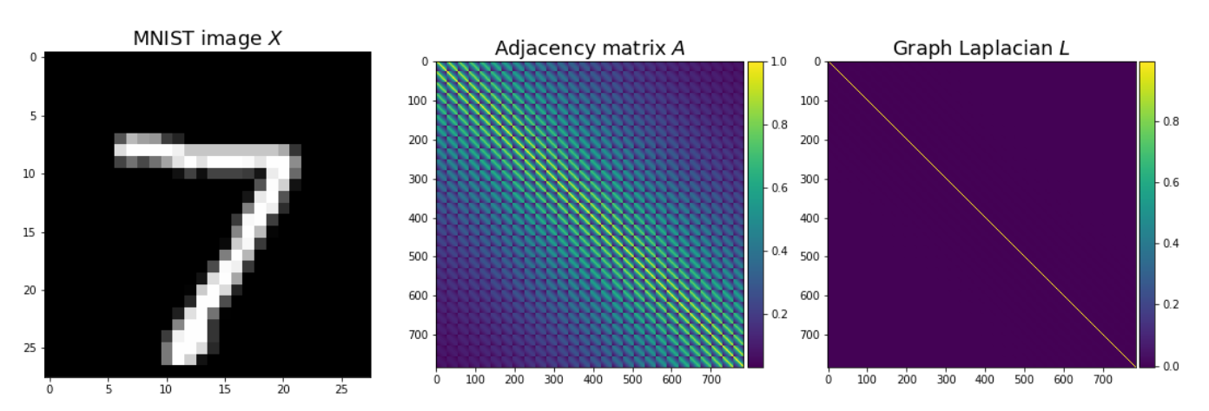
Graph Spectral Convolution MNIST

Slide 31
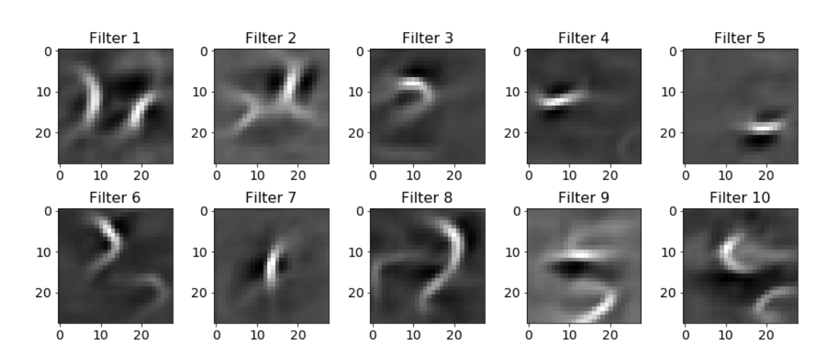
Learned Graph Spectral Filters

Slide 32
Problems
Problem 1: The filters are no longer localized operations
They are operating globally based on frequency characteristics
Fix: To localize in the spatial domain you need smoothness in the Fourier domain
Smoothness achieved by restricting filters to polynomial filters with K coefficients
K coefficients gives K-node localization!
Fix 2: Use wavelet filters instead of fourier
Wavelets are localized in time and space
Problem 2: Fourier transform is expensive, eigendecomposition of an NxN matrix each time
Fix: Chebyshev approximation
Fix2: Diffusion based operations

Slide 33
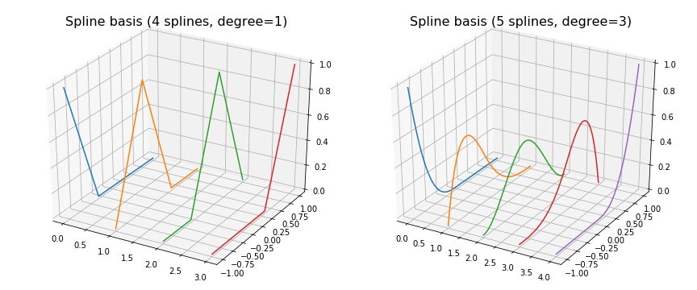

K filter coefficients

Slide 34
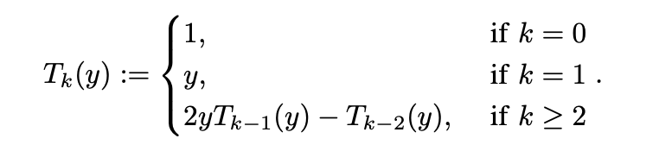

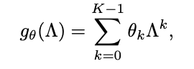
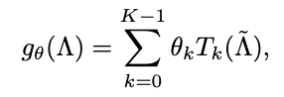
Chebyshev Polynomials
Avoiding eigendecomposition which is expensive
Chebyshev polynomials of the graph Laplacian defined recursively
Original Spectral Filters
Polynomial Filters
Chebyshev Filters

Slide 35
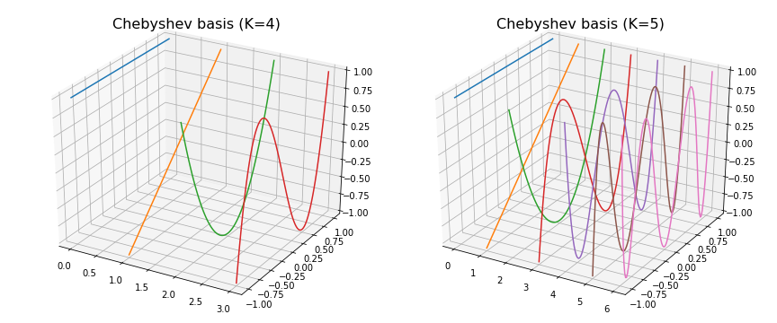
Chebyshev Basis

Slide 36
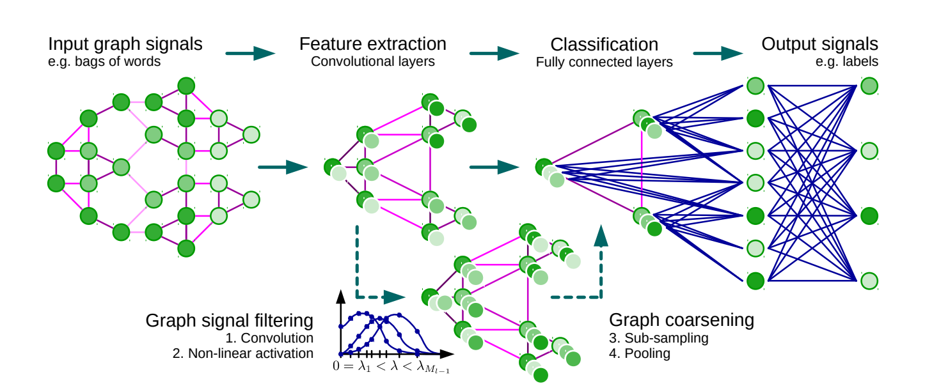
Summarized Architecture of GCN

Slide 37
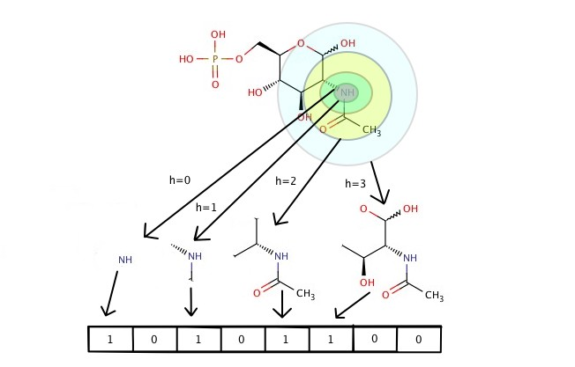
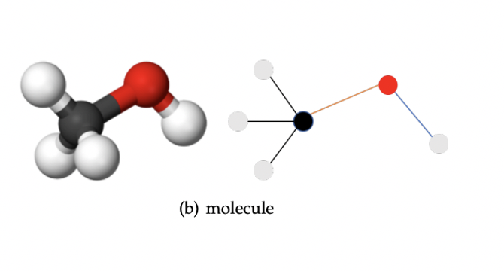
Applications
Predicting Molecular properties by encoding molecules as graphs

Slide 38
Global vs Local Frequency Domain Analysis
Fourier transforms capture global frequency information, frequencies that persist over the entire length of the signal
What about small bursts of frequency changes?
Uneven frequency distributions over time?
These might benefit from a more localized frequency domain analysis

Slide 39
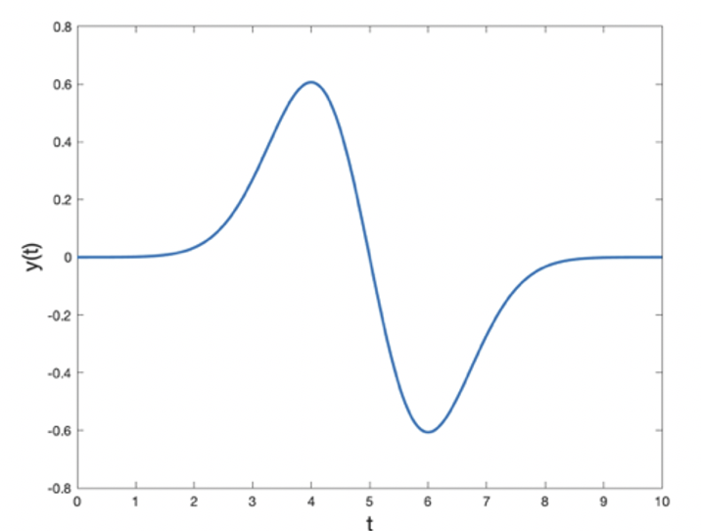
Wavelets
Unlike a sine or cosine function a wavelet is a localized oscillation

Slide 40
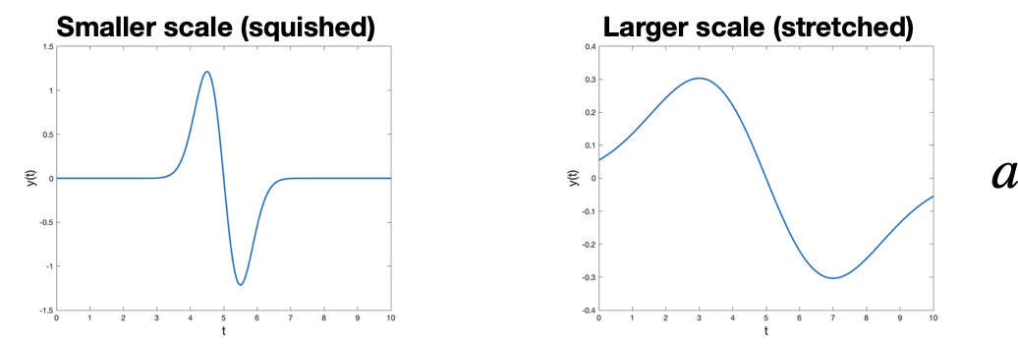
Scaling wavelets

Slide 41
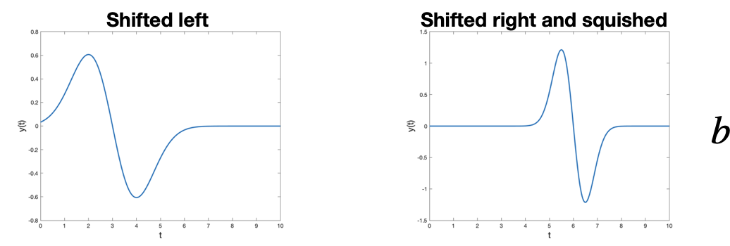
Shifting wavelets in time

Slide 42
Discrete Wavelet Transform

Slide 43
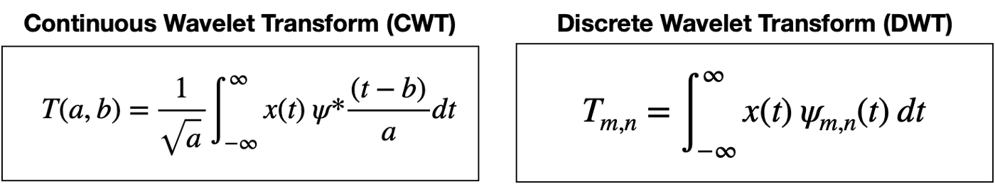
Wavelet Transform

Slide 44
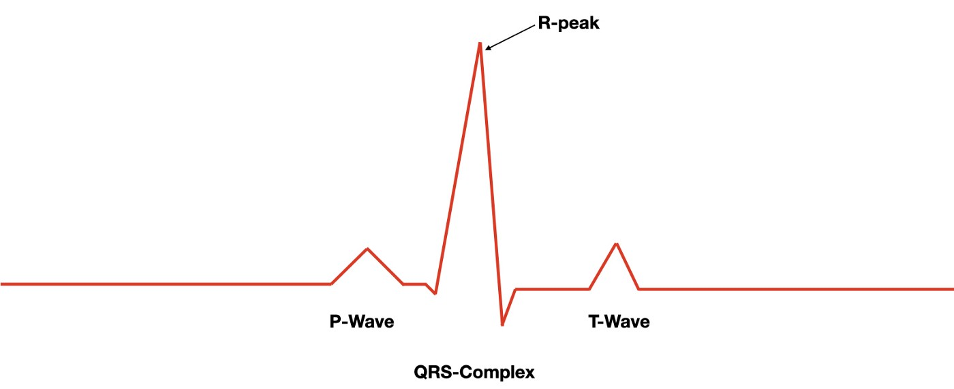
Sample Application peak detection in EEG

Slide 45
Diffusion Operator
.2 | .2 | 0 | .2 | .2 | .2 | 0
.333 | .333 | 0 | 0 | 0 | .333 | 0
0 | 0 | .25 | .25 | .25 | 0 | .25
.25 | 0 | .25 | .25 | .25 | 0 | 0
.25 | 0 | .25 | .25 | .25 | 0 | 0
.25 | .25 | 0 | 0 | 0 | .25 | .25
0 | 0 | .333 | 0 | 0 | .333 | .33
1 | 1 | 0 | 1 | 1 | 1 | 0
1 | 1 | 0 | 0 | 0 | 1 | 0
0 | 0 | 1 | 1 | 1 | 0 | 1
1 | 0 | 1 | 1 | 1 | 0 | 0
1 | 0 | 1 | 1 | 1 | 0 | 0
1 | 1 | 0 | 0 | 0 | 1 | 1
0 | 0 | 1 | 0 | 0 | 1 | 1
4
2
0.2
0.2
1
0.2
3
0.2
5
$$P=D^{−1}A$$
6
7
Same eigenvectors as the graph laplacian

Slide 46

Diffusions can be used to create wavelets
Diffusion Atoms
P^{t} s gives diffused version of S
Diffusion based filters don’t require eigendecomposition

Slide 47


Diffusion wavelets: Differences between lazy Random walks
D
Coifman and Maggioni

Slide 48

Scattering transform
Multiscale Wavelet transform
Coefficients collected via a non-linearity

Slide 49

Graph Classification

Slide 50
Graph Classification

Slide 51

Embedding Analysis

Slide 52

Graph Scattering Autoencoder Embeddings
Toy Graph Trajectory
Castro et al. 2019

Slide 53

Bistable RNA Structure
SEQ3

Slide 54
Reading list
Defferrard et al. Convolutional Neural Networks on Graphs
Kipf & Welling Semisupervised Graph Classification
https://towardsdatascience.com/spectral-graph-convolution-explained-and-implemented-step-by-step-2e495b57f801
Graph wavelet neural network https://arxiv.org/pdf/1904.07785.pdf
Graph scattering Autoencoder: https://arxiv.org/abs/2006.06885
Learnable scattering network: https://arxiv.org/abs/2010.02415
Diffusion wavelets: https://www.sciencedirect.com/science/article/pii/S106352030600056X

